Slide 1
2021-04-14
Chaos and Deep Learning
Juwon Park
Dept. of Physics, University of Seoul
yuni990913@gmail.com

Slide 2
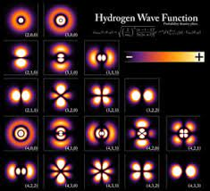
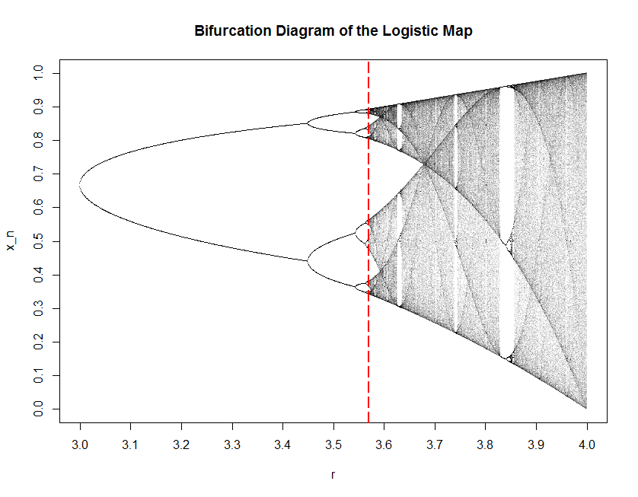
Deterministic Problem
Notes:
Sophicated.
instrinct
Matyr stochastic TR

Slide 3
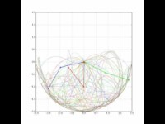
Deterministic Problem
Notes:
Constraint unpredictable.
Senstive against initial values

Slide 4
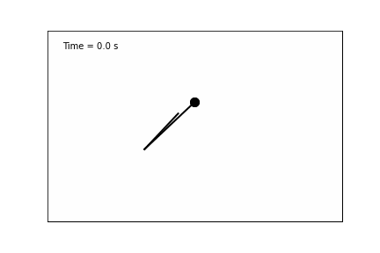
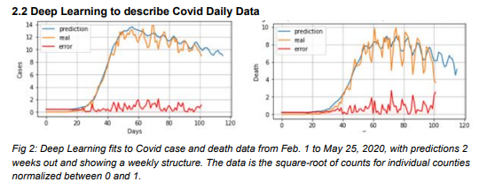
Ancestors
William Gropp, Deep Learning with Real Data and the Chaotic Double Pendulum(2021)
Geoffery Charles Fox, DRAFT Deep Learning for Spatial Time Series(2020), University of Virginia.
Notes:
Really dizzy.

Slide 5
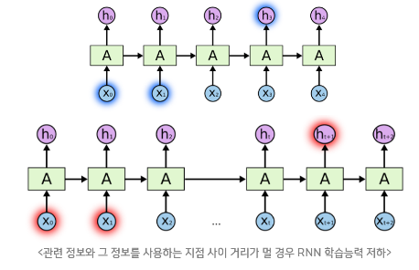
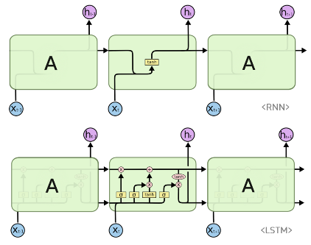
Deep Learning Nutshell Concept
https://ratsgo.github.io/natural%20language%20processing/2017/03/09/rnnlstm/
Notes:
Nutshell : generate big big array.

Slide 6
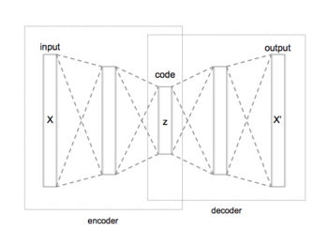
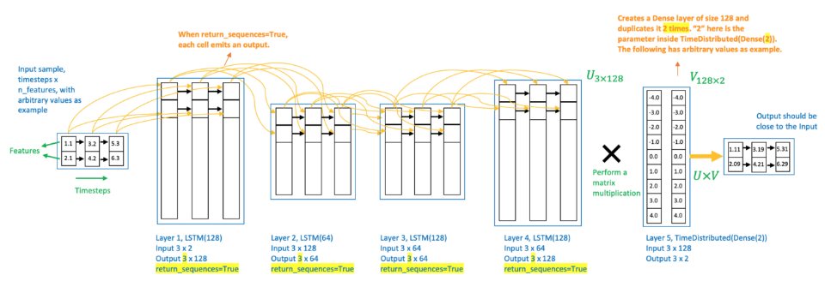
Deep Learning Nutshell Concept
https://towardsdatascience.com/step-by-step-understanding-lstm-autoencoder-layers-ffab055b6352
Notes:
Ruined arbitrary to make sth realitistic

Slide 7
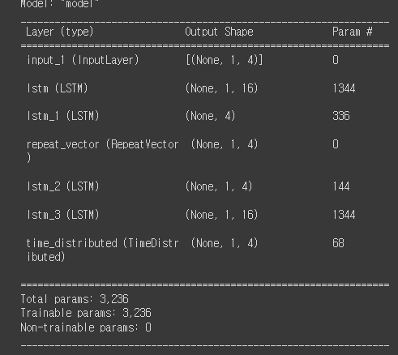
Deep Learning Nutshell Concept
25 Epoch iteration
Picked Validation set 5 % of train set
2:1 = train: test
Batch_size = 5
Notes:
25 Epoch iteration
Picked Validation set 5 % of train set
2:1 = train: test
Batch_size = 5

Slide 8
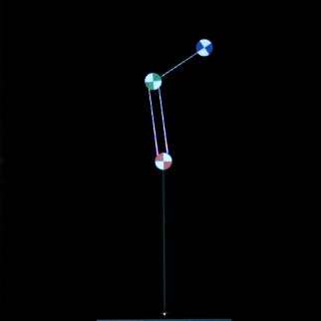

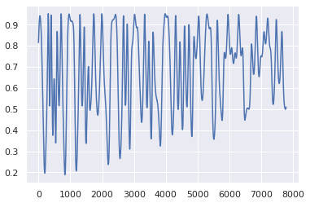
Failure Notes
Every Graphs have y-axis means angular rescaled from [pi/2, -pi/2] to
[0,1] and x-axis means 10 ms
Notes:
IBM data to find usual and normal ones for every data.
And processed preparation of data in similar way. Because so many researchors follow such a way.
And it is plausible to follow previous contiribution’s frame.
PBased Runge Kutta 4 Method and it is to find a optimization solution of DE.

Slide 9
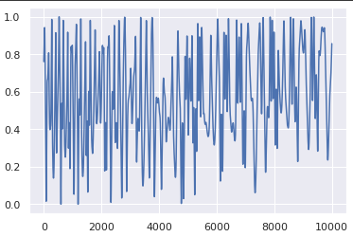
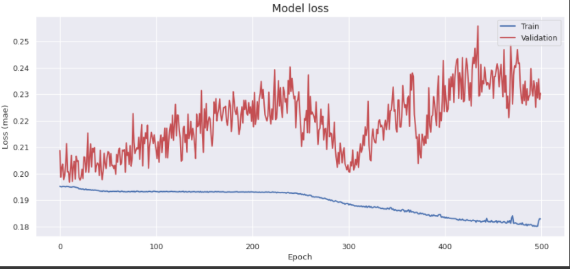
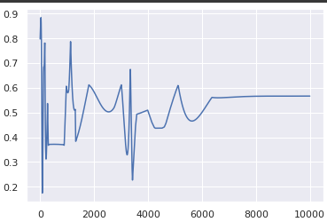
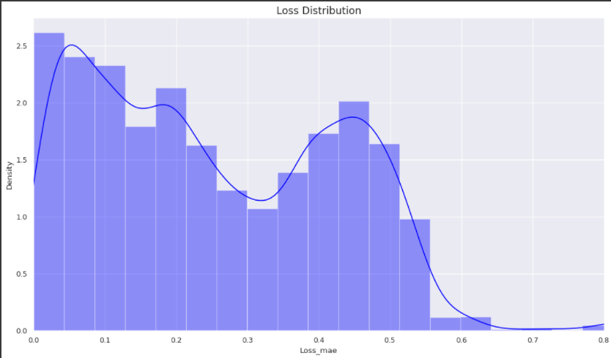
Failure Notes : time onto value
Notes:
Time to physical values.

Slide 10
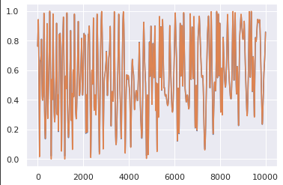
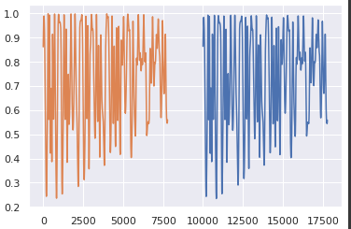
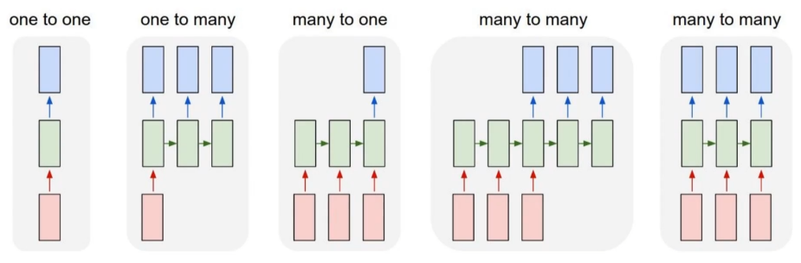
Failure Notes : one to one problem
Notes:
Many to many

Slide 11
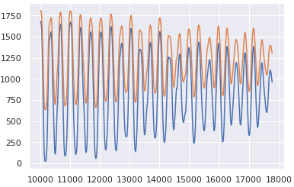
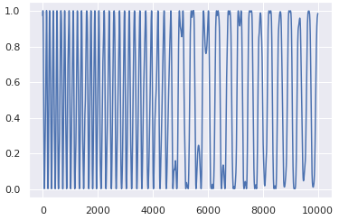
Failure Notes : Trivial
Chart11-1. Easy_test
Chart11-2. Easy_train
Notes:
If data is too easy it leads to vomit everything intake

Slide 12
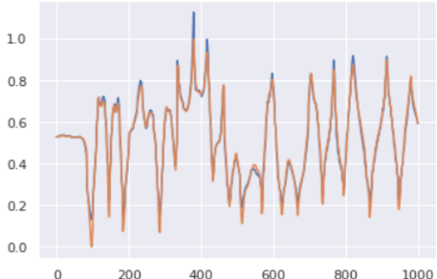
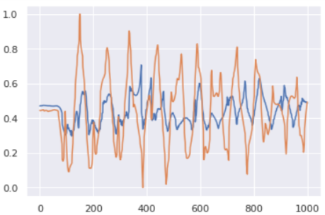
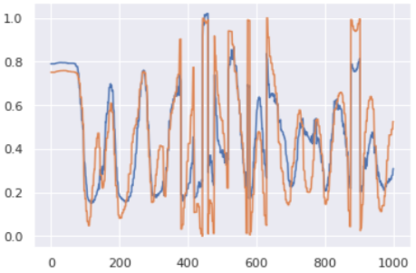
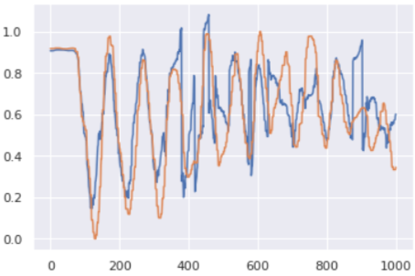
Result
Chart12-1 Lower Angular Velocity
Chart12-3 Upper Angular Velocity
Chart12-2 Lower theta
Chart12-4 Upper theta

Slide 13
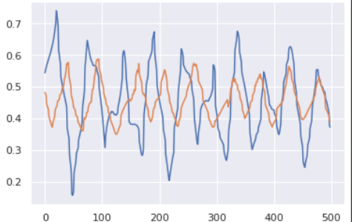
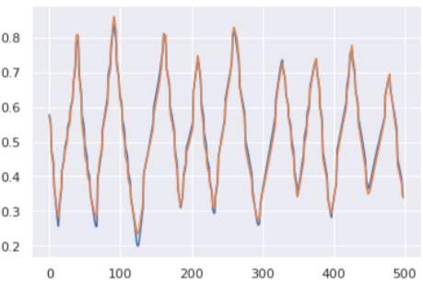
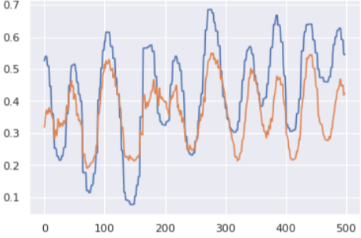
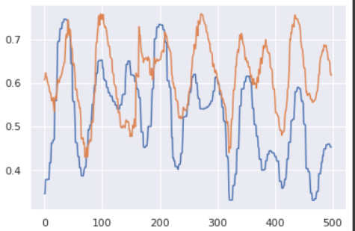
Result
Chart13-1 Lower Angular Velocity
Chart12-3 Upper Angular Velocity
Chart13-2 Lower theta
Chart13-4 Upper theta
Notes:
Case one. Perfectly fitted.
Case two. Normal case. Back shift.
Case third and fourth. Fantastic and those are ones what I am looking

Slide 14
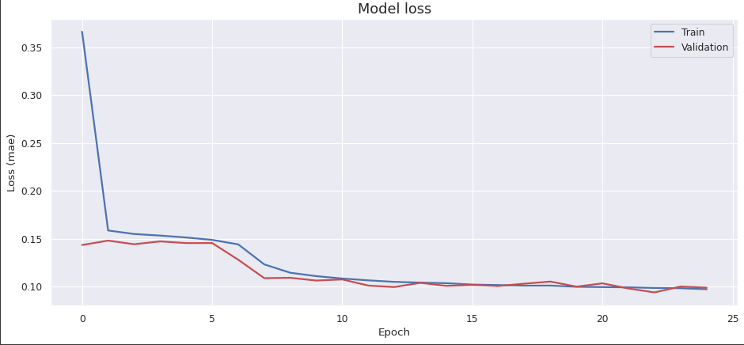
Result
 | ThetaU | AngU | ThetaL | AngL
Cos-sim | 0.982 | 0.964 | 0.981 | 0.999
Valid t | 0.7sec | Back_shfitted | 1.2 sec | 5sec

Slide 15
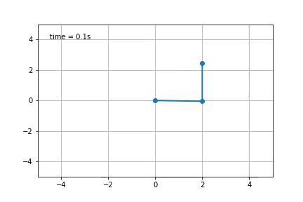
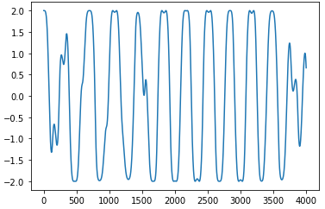
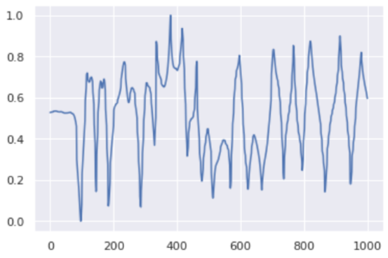
Result
Notes:
Suggest
calibration
Acuminate
Further subject. Diff with real and simulated

Slide 16
Thank you for listening!

